Slide 1

Release-monitoring.org
Michal Konečný

Slide 2
Agenda
Basic Sorcery
  What is release-monitoring.org?
Anitya
  Realm of Magic
The-new-hotness
  Floating Island in Realm of Magic
Integration to Packager Workflow
  Where the Magic Happens
References

Slide 3


Slide 4
Basic Sorcery
What is release-monitoring.org?
  Anitya – web interface
    Allows users to add projects to watch for new releases
    Automatically checks for new releases
    Sends fedora message when new version is retrieved
  The-new-hotness - fedora messaging consumer
    Listens to messages emitted by Anitya
    Creates or updates bugzilla when new release is found
    Starts scratch builds if configured

Slide 5
Anitya
Realm of Magic

Slide 6
Magic Numbers (Statistics)
First commit: 28th November 2013
First release: 0.1.0 - 29th September 2014
Contributions
  Commits: 1937
  Contributors: 53
  Issues created: 466
  Issues closed: 375
Current version: 0.18.0
Number of projects watched by release-monitoring.org: 126435
  Mapped to OpenSuse: 331

Slide 7
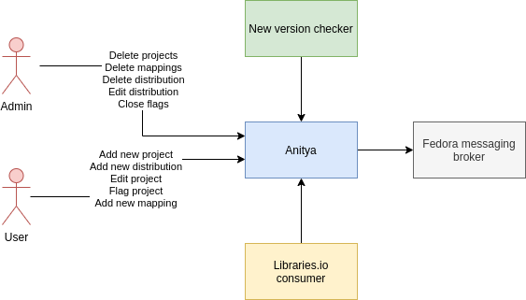

Slide 8
Current situation
Milestone 1.0 is currently being work on
  https://github.com/fedora-infra/anitya/milestone/6
Anitya is part of Hacktoberfest event
  https://hacktoberfest.digitalocean.com

Slide 9
The-new-hotness
Floating Island in Realm of
Magic

Slide 10
Magic Numbers (Statistics)
First commit: 13th March 2014
First release: 0.1.2 - 17th November 2014
Contributions
  Commits: 440
  Contributors: 22
  Issues created: 141
  Issues closed: 121
Current version: 0.13.1

Slide 11
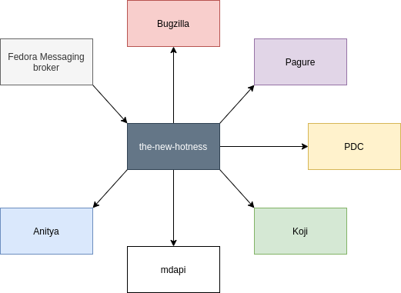

Slide 12
Current situation
Milestone 1.0 is currently being work on
  https://github.com/fedora-infra/the-new-hotness/milestone/2
The-new-hotness is part of Hacktoberfest event
  https://hacktoberfest.digitalocean.com

Slide 13
Integration to Package Workflow
Where Magic Happens

Slide 14
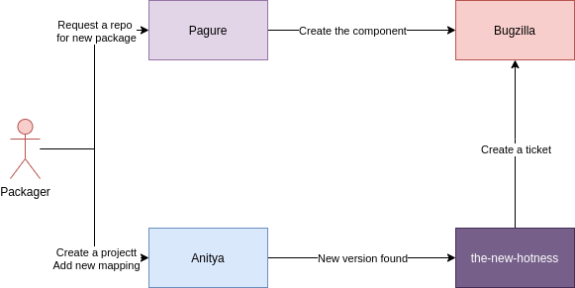

Slide 15
Demo

Slide 16
References
Release-monitoring.org blogposthttps://communityblog.fedoraproject.org/tag/release-monitoring-org/
Release-monitoring.org
https://release-monitoring.org/
Anitya – repository
https://github.com/fedora-infra/anitya
The-new-hotness – repository
https://github.com/fedora-infra/the-new-hotness

Slide 17

Finish
Thank You

